Slide 1




Project Brief
Brief by Joe Kinglake

Slide 2

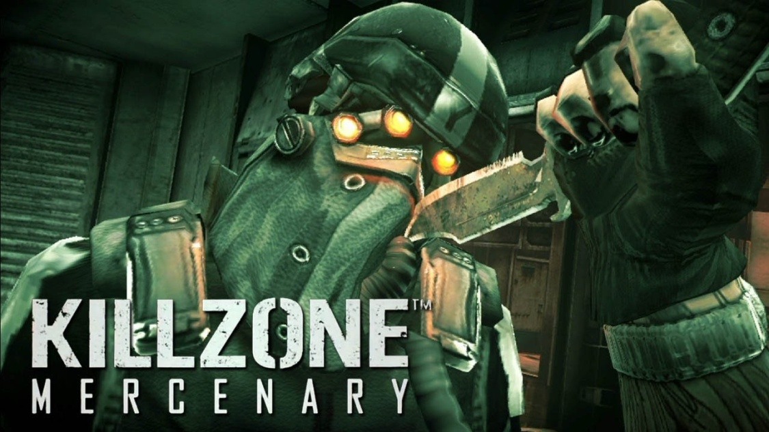
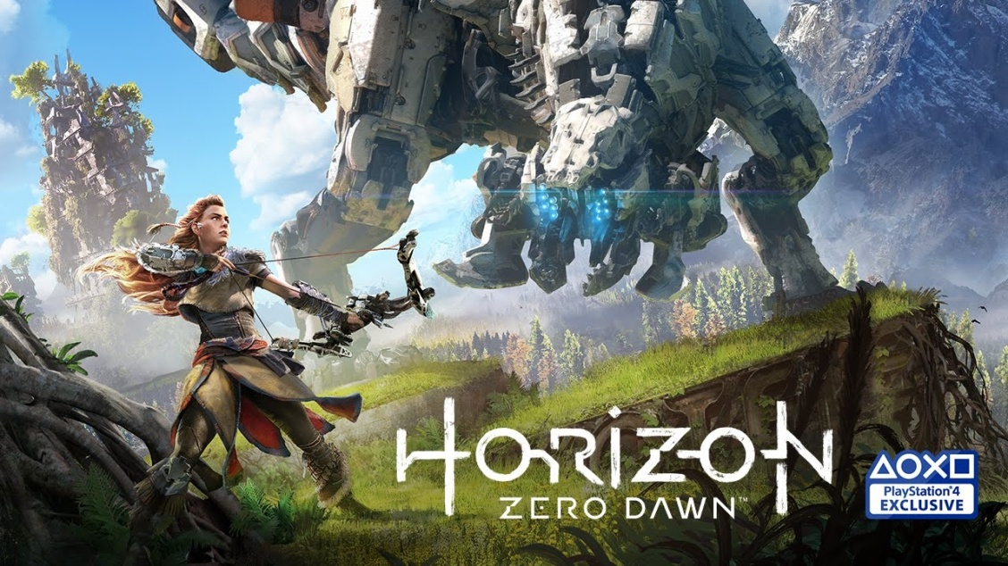
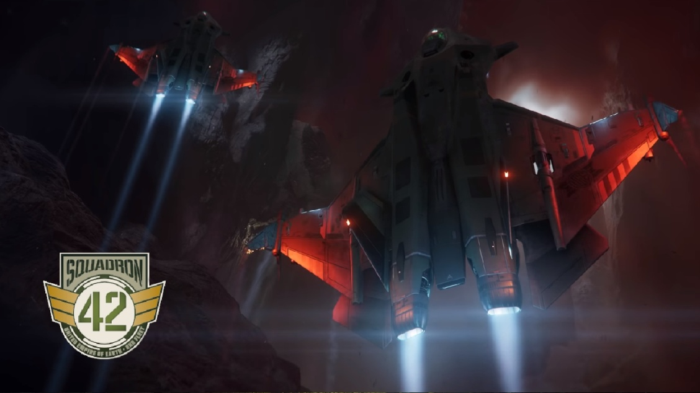
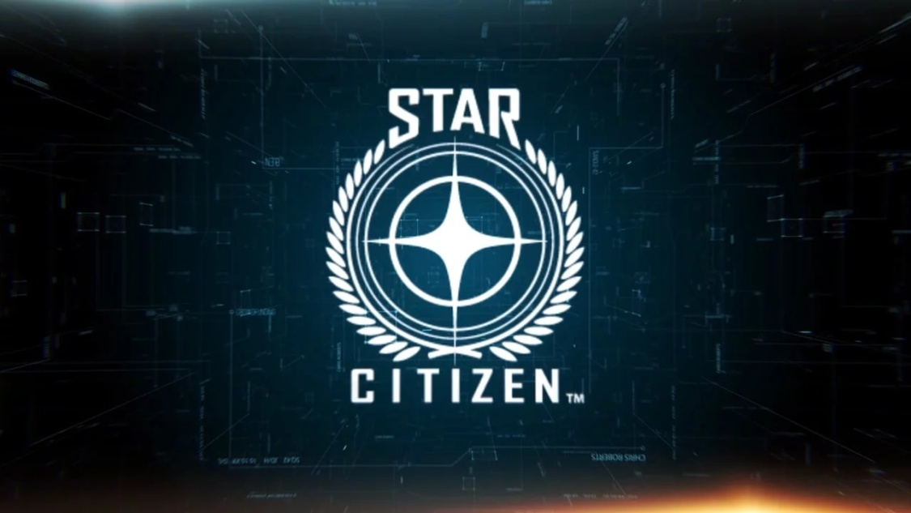

Introduction
UNIVERSITY OF SUFFOLK
KILLZONE: MERCENARY SONY CAMBRIDGE
HORIZON ZERO DAWN GUERRILLA AMSTERDAM
STAR CITIZEN: SQUADRON 42 FOUNDRY 42
STAR CITIZEN: ONLINE FOUNDRY 42
HITMAN 2 SUMO DIGITAL & IOI

Slide 3
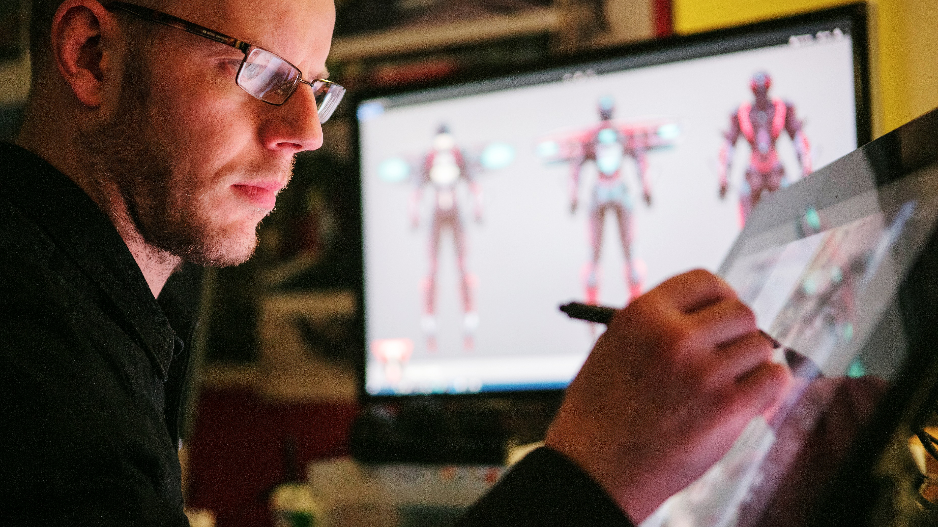
SUMO DIGITAL
Founded in 2003
Licensed developer across all Microsoft, Sony and Nintendo gaming platforms
Expertise in developing and growing licensed IP
Always on the cutting edge

Slide 4
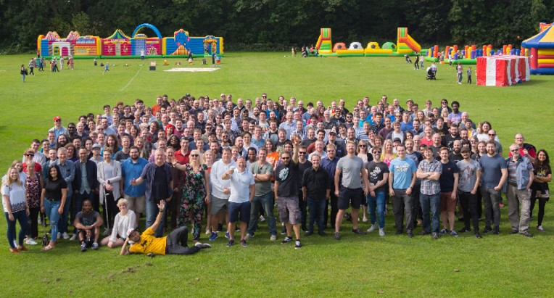
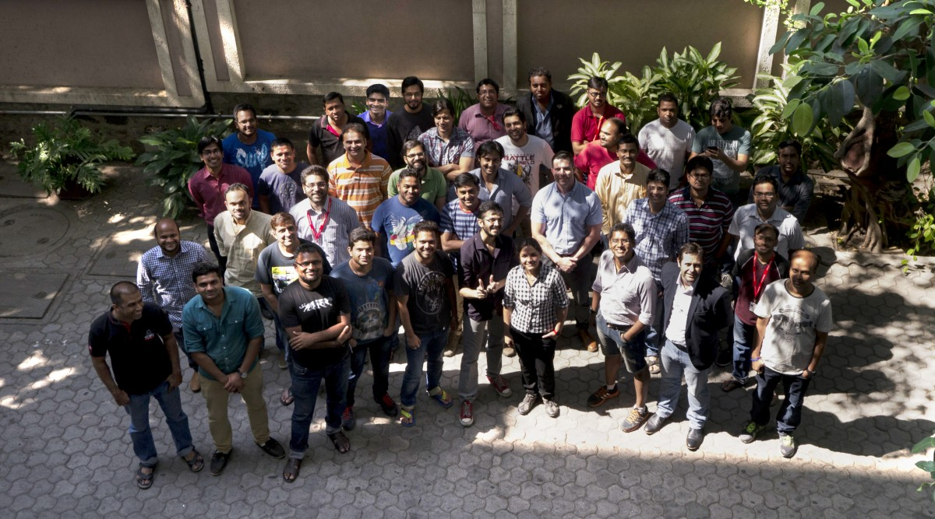
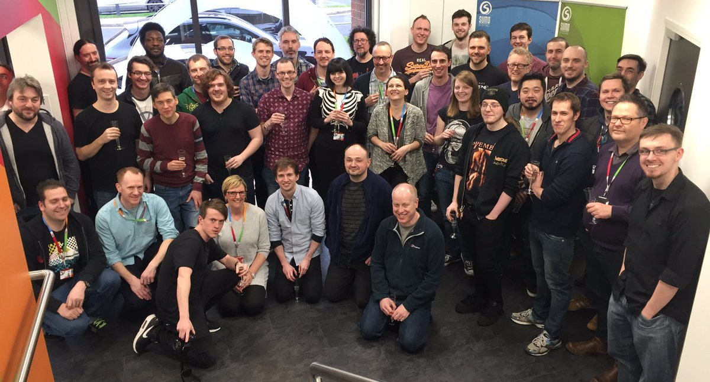
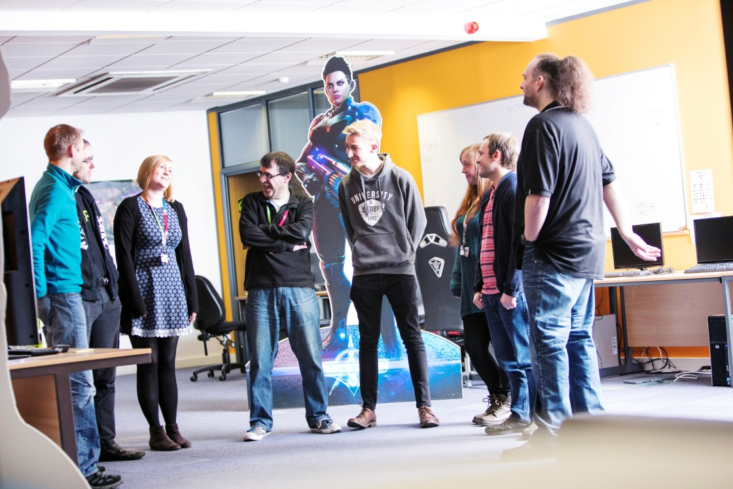
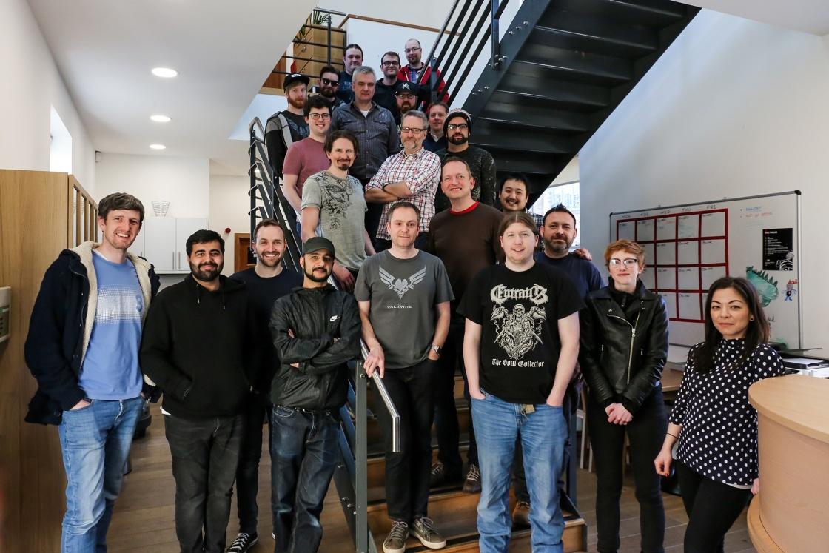

Studios
SHEFFIELD
Founded in 2003 300+ Staff
PUNE, INDIA
Founded in 2007 80+ Staff
NOTTINGHAM
Founded in 2016 70+ Staff
NEWCASTLE
Founded in 2018 35+ Staff
THE CHINESE ROOM, BRIGHTON
Acquired in 2018

Slide 5
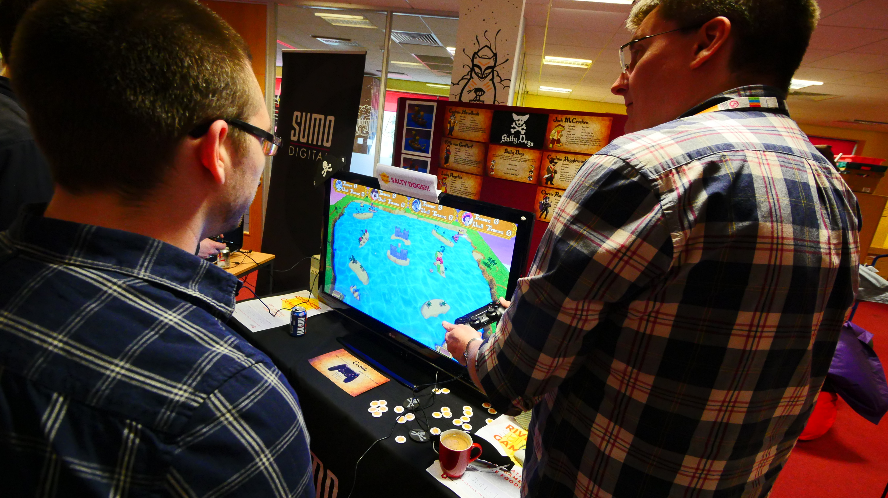
Game Jams & Sumo
Twice annual game jam
2 weeks long
Open to all developers
Stretch our creative wings
Free from project constraints
Explore interesting ideas
Part of the Sumo culture
Notes:
Game jams are an important part of the Sumo culture. Held twice a year they give developers chance to stretch their creative wings, free from project constraints, to explore new & interesting ideas.

Slide 6
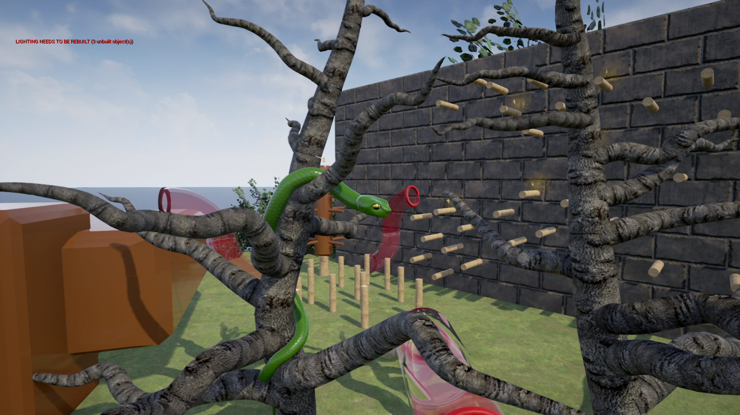

Slide 7
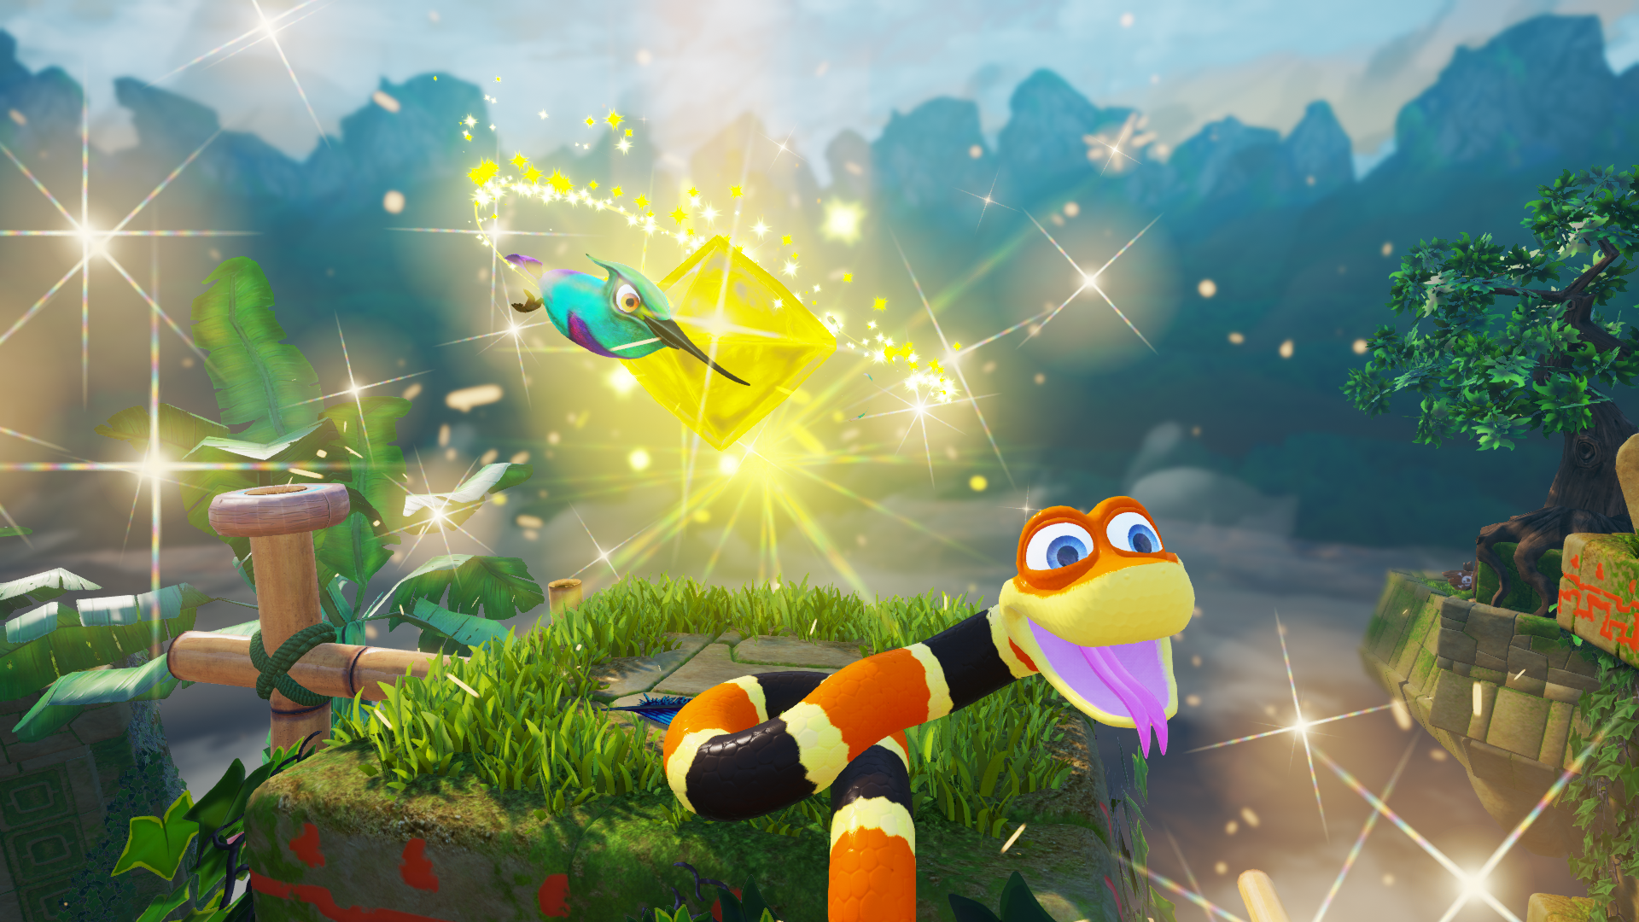

Slide 8
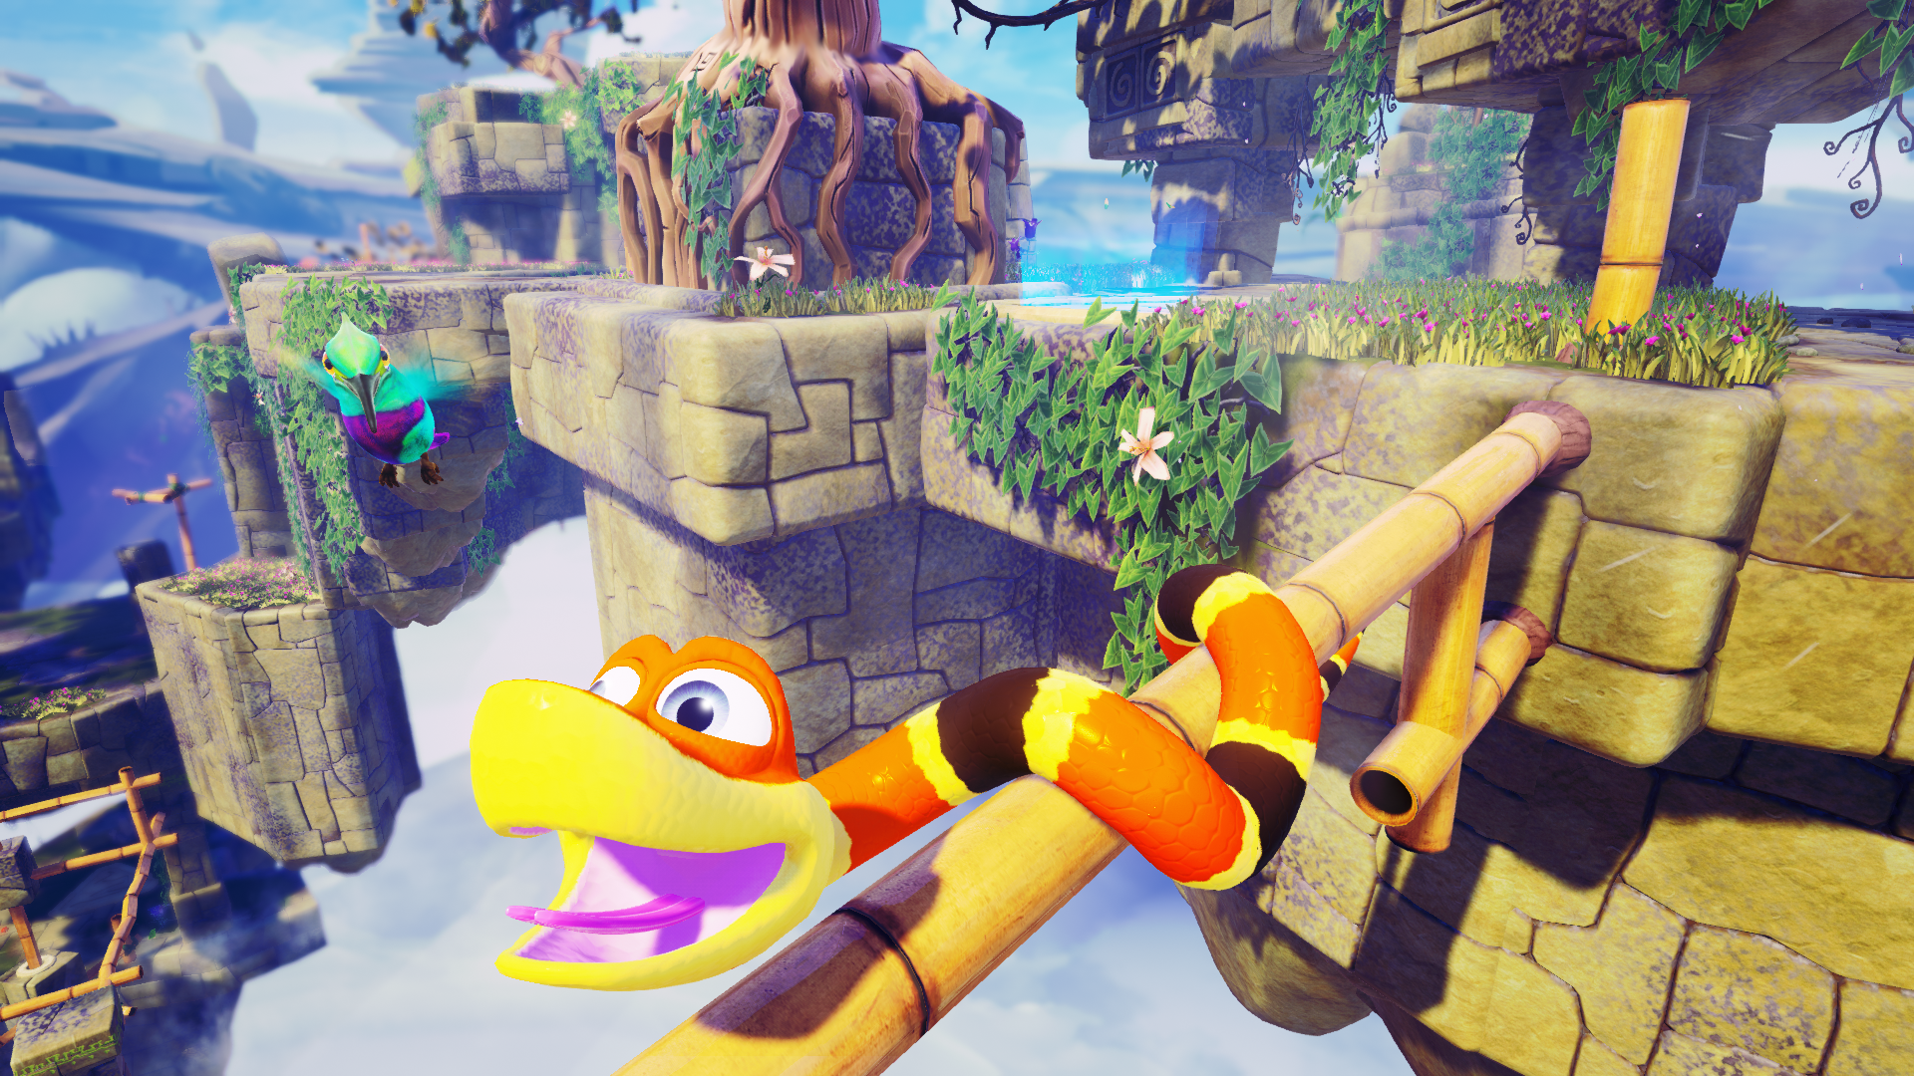
Case Study: Snake Pass
Snake Pass was developed during a game jam by Sebastiaan Liese for the Sumo internal game jam.
3D Platformers traditionally focus around the navigation of 3D spaces with jumping as a focal mechanic.
Snake Pass asks the question, what would a 3D platformer look like without the ability to jump?
Focus is still given to navigation of 3D spaces but mechanics force players to change what they know about 3D spatial navigation.
Simple problems in a traditional 3D platformer such as small gaps become a puzzle for the player to solve in Snake Pass.

Slide 9
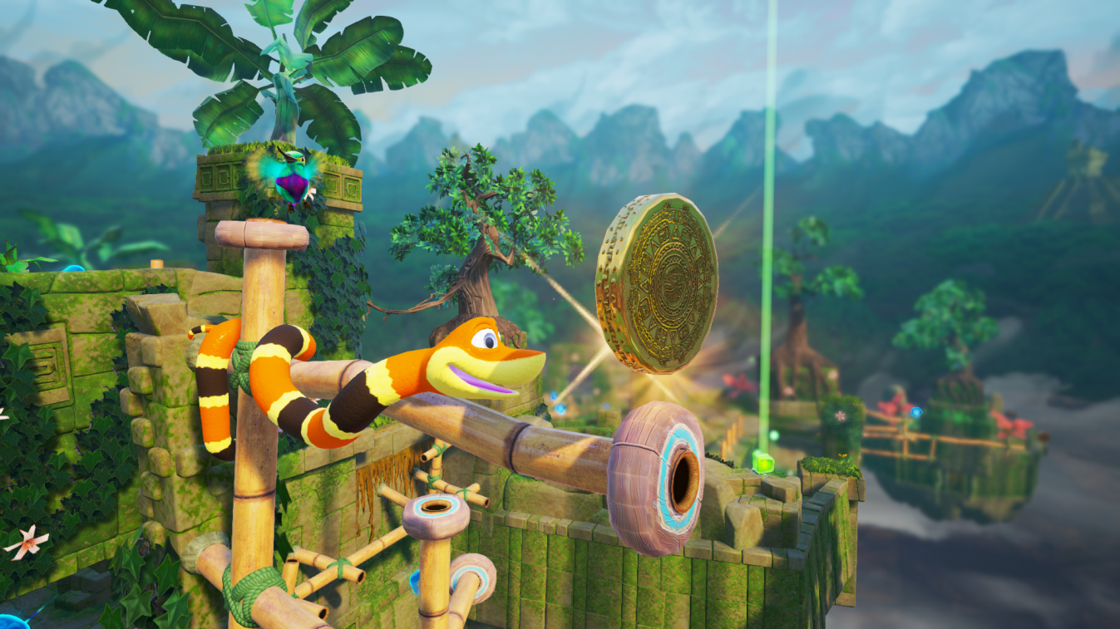
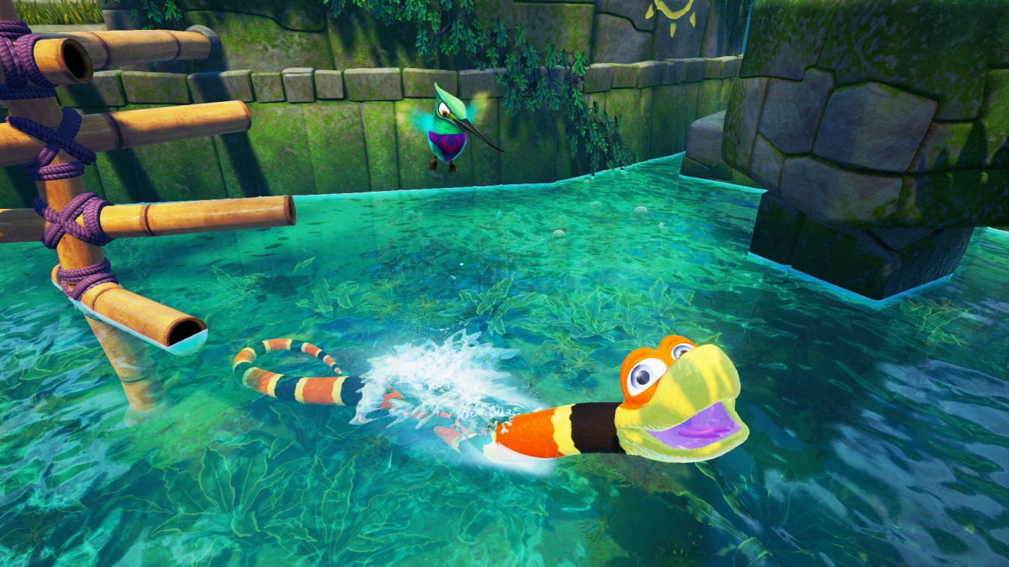
Assignment
Singleplayer game
Consider a genre or type of games that have a typical mechanic or set of mechanics defined as integral to them
Develop a game without the specified mechanic or mechanic set
Substitute the mechanic with a refined new solution to the problem that removing the mechanic creates
Emphasis on a single mechanic
Notes:
Design by abstraction

Slide 10
Why Remove A Mechanic?
Removal of a mechanic that is integral to a genre will create a new set of unique problems to solve.
The creation of these unique new problems will facilitate creative solutions and promote distinct game designs.
Why Singleplayer?
Focus on getting your mechanics in and iterated quickly instead of combatting the technical challenges associated with multiplayer games

Slide 11
Deliverable
A game that is self contained and needs no explanation from the developer to play.
Emphasis on the gameplay experience
A game that abstracts itself from the conventions of a genre by removing a key mechanic or set of mechanics

Slide 12

TIP: Game Jam Idea Generation
Spend a day jamming on an idea to prove its feasibility
Use a short form game jam to experiment with mechanical ideas
Game Jams provide a low risk environment to experiment
Timeboxing means that risk is limited
Promotes simple idea generation

Slide 13
TIP: Research & Reference
Look outside your usual set of references
Find reference material that are not just video games
Abstract and combine references
Filter references through your own style
Consider the application of non-game theory to game design

Slide 14
TIP: Playtest & Iteration
Play your own game and test in context
Playtest often
Avoid interference
Playtest with a wide and changing user set
Obtain qualitative & quantitative data
Feed playtest feedback into your iterations

Slide 15

GOOD LUCK!
Jkinglake@Sumo-Digital.com
@JoeKinglake

